Slide 1


MathE
Improve Math Skills in Higher Education
Third Partners’ Meeting
Limerick (IT), 2 – 3 December 2019

Slide 2

Funding Programme
European Commission funded through the Portuguese National Agency the MathE project in the framework of the Erasmus+ Programme – Strategic Partnerships for Higher Education Action.
Project number: 2018-1-PT01-KA203-047361

Slide 3
Expected Results
The main project tangible results are 3 intellectual outputs:
Students’ Assessment Toolkit
Online Math Library of Video Lessons and Educational Material
Teachers’ and Students’ Community of Practices

Slide 4
Project Activities

Slide 5
The Project at a Glance
Involvement of target groups | October 2018 – December 2018
Student's Assessment Toolkit | October 2018 – December 2019
Online Math Library of Video Lessons and Teaching Materials | March 2019 – September 2020
Teachers’ and Students’ Community of Practice | May 2020 – January 2021
Training Actvity | November 2020
Multiplier Events | January 2021

Slide 6
Preparatory Activity
(part of the Project Management)
Target Groups Involvement

Slide 7
PM1: Project Management 1/5
Actions to be Carried Out
Involvement of target groups:
  25 lecturers
  100 students

Slide 8
PM1: Project Management 2/5
Templates and Tools
PM1.A – Lecturer Information
PM1.B – Student Information
PM1.C – Role of the Target Groups

Slide 9
PM1: Project Management 3/5
Expected Results
Each partner should select and upload on the project portal at least:
  5 Lecturers
  20 Students

Slide 10
PM1: Project Management 4/5
Current Results
Partner | Lecturers | Students
IE_LIT | 7 | 16
IT_UniGenova | 6 | 22
LT_KTU | 5 | 120
PT_IPB | 13 | 119
Ro_UniIasi | 6 | 41
 | 35 | 221

Slide 11
PM1: Project Management 5/5
Deadlines
15 December 2019
LIT (IE)
Upload on the project portal the target group information

Slide 12
Intellectual Output 1
Student's Assessment Toolkit

Slide 13
IO1: Student's Assessment Toolkit 1/12
Actions to be Carried Out
IO1.1) Creation of all templates needed for carrying out the activities | 1 October 2018 15 October 2018
IO1.2) Development of the dedicated project portal section | 1 October 2018 30 November 2018
IO1.3) Definition of the questions for the Assessment Tools | 1 October 2018 30 June 2019
IO1.4) Review of the questions for the Assessment Tools | 1 April 2019 31 December 2019

Slide 14
IO1: Student's Assessment Toolkit 2/12
Templates and Tools
IO1.A – Assessment Tools

Slide 15
IO1: Student's Assessment Toolkit 3/12
Expected Results
Identification of 10 Math topics
Distribution of 2 Math topics per HEI
Each HEI partner for each of the 2 Math topics should define:
  40 questions/answer for the Student Need Assessment Tool
  20 questions/answer for the Student Assessment Tool
EuroED will give technical support to TUIasi
Each HEI partner should review questions/answers for at least 3 Math topics

Slide 16
IO1: Student's Assessment Toolkit 4/12
Possible Topics
Web Services
Manipulation of algebraic expressions (LIT)
Trigonometric functions
Real Functions of a single variable (UniGenova)
Differentiation
Integration (IPB)
Matrix and determinats (KTU)
Geometrical interpretation
EigenValues and EigenVectores
Linear systems (UniGenova)
Complex Numbers
Graphs (LIT)
Optimization (IPB)
Limits and sequences
Statistics (KTU)
Real Functions of several variables (TUIasi)
Differential equations (TUIasi)
MathJax
https://www.mathjax.org/
Guppy
https://guppy.js.org/site/

Slide 17
IO1: Student's Assessment Toolkit 5/12
Current Results
Fundamental Mathematics
  Manipulation of algebraic expressions
  Geometry
Complex Numbers
Probability
Statistics
Analytic Geometry
Graph Theory
Differentiation
Derivatives
Partial differentiation
Integration
Integration Techniques
Double Integration

Slide 18
IO1: Student's Assessment Toolkit 6/12
Current Results
Linear Algebra
Matrix and determinants
Eigenvalues and Eigenvectors
Linear systems
Vector Spaces
Linear Transformations
Optimization
Linear Optimization
Nonlinear Optimization
Real functions of a single variable
Limits and Continuity
Domain, Image and Graphs
Real functions of several variables
Differential equations

Slide 19
IO1: Student's Assessment Toolkit 8/12
Current Results/Self Assessment
Uploaded Questions
Partner | To be evaluated | Approved | Submitted
IE_LIT | 0 | 100 | 100
IT_UniGenova | 2 | 78 | 80
LT_KTU | 0 | 80 | 80
PT_IPB | 19 | 482 | 501
RO_UniIasi | 4 | 109 | 113
Tot | 23 | 851 | 874

Slide 20
IO1: Student's Assessment Toolkit 9/12
Current Results/Self Assessment
Topic/Subtopic | Questions submitted | Questions approved | Questions reviewed | Questions to be reviewed
Analytical Geometry (IPB) | 40 | 40 | 40 (UniGe)
Complex Numbers (IPB) | 33 | 33 | 33 (UniGe)
Differential equations (TUIasi) | 42 | 41 | 42 (IPB)
Differentiation
Derivatives (LIT) | 47 | 46 | 46 (IPB)
Partial differentiation (IPB) | 43 | 32 | 39 (IPB) | 9 (IPB)
Fundamental Mathematics
Elementary Geometry (IPB) | 48 | 44 | 48 (LIT)
Manipulation of algebraic expressions (LIT) | 52 | 40 | 52 (IPB)
Graphs Theory (IPB) | 53 | 48 | 53 (TUIasi)

Slide 21
IO1: Student's Assessment Toolkit 9/12
Current Results/Self Assessment
Topic/Subtopic | Questions submitted | Questions approved | Questions reviewed | Questions to be reviewed
Integration
Double Integration (IPB) | 40 | 40 | 40 (IPB)
Integration Techniques (IPB) | 40 | 40 | 40 (KTU)
Linear Algebra
Eigenvalues and Eigenvectors (IPB) | 40 | 40 | 40 (IPB)
Linear systems (UniGenova) | 51 | 51 | 51 (IPB)
Linear Transformations (IPB) | 40 | 40 | 40 (TUIasi)
Matrices and Determinants (KTU) | 41 | 40 | 41 (LIT)
Vector Spaces (IPB) | 40 | 40 | 40 (UniGE)

Slide 22
IO1: Student's Assessment Toolkit 10/12
Current Results/Self Assessment
Topic/Subtopic | Questions submitted | Questions approved | Questions reviewed | Questions to be reviewed
Optimization
Linear Optimization (IPB) | 41 | 31 | 31 (TUIasi) | 10 (TUIasi)
NonLinear Optimization (TUIasci + IPB) | 41 | 40 | 40 (TUIasi, LIT)
Probability | 46 | 46 | 46 (KTU)
Real functions of single variables (UniGe)
Limits and Continuity (UniGe) | 21 | 21 | 21 (KTU) | 4 (KTU)
Domain, Image and Graphics (UniGe) | 17 | 17 | 17 (KTU)
Real functions of several variables (TUIasi)
Limits, Continuity, Domain and Image ((TUIasci + IPB) | 49 | 39 | 49 (LIT)
Statistics (KTU) | 40 | 40 | 40 (IPB)

Slide 23
IO1: Student's Assessment Toolkit 8/12
Current Results/Final Assessment
Uploaded Questions
Partner | To be evaluated | Approved | Submitted
IE_LIT | 43 | 0 | 43
IT_UniGenova | 29 | 11 | 40
LT_KTU | 0 | 40 | 40
PT_IPB | 72 | 26 | 98
RO_UniIasi | 10 | 0 | 15
Tot | 174 | 31 | 205

Slide 24
IO1: Student's Assessment Toolkit 9/12
Current Results/Final Assessment
Topic/Subtopic | Questions submitted | Questions approved | Questions reviewed | Questions to be reviewed
Analytical Geometry (IPB) |  |  | (UniGe)
Complex Numbers (IPB) |  |  | (UniGe)
Differential equations (TUIasi) |  |  | (IPB)
Differentiation
Derivatives (LIT) | 23 |  | 0 (IPB) | 23 (IPB)
Partial differentiation (IPB) | 5 |  | 0 (IPB) | 5 (IPB)
Fundamental Mathematics
Elementary Geometry (IPB) | 10 |  | 0 (LIT) | 10 (LIT)
Manipulation of algebraic expressions (LIT) | 20 |  | 20 (IPB) | 20 (IPB)
Graphs Theory (IPB) |  |  | (TUIasi)

Slide 25
IO1: Student's Assessment Toolkit 9/12
Current Results/Final Assessment
Topic/Subtopic | Questions submitted | Questions approved | Questions reviewed | Questions to be reviewed
Integration
Double Integration (IPB) | 20 | 20 | 20 (IPB)
Integration Techniques (IPB) | 20 |  | 0 (KTU) | 20 (KTU)
Linear Algebra
Eigenvalues and Eigenvectors (IPB) |  |  | (IPB)
Linear systems (UniGenova) | 20 | 11 | 11 (IPB) | 9 (IPB)
Linear Transformations (IPB) | 20 |  | 0 (TUIasi) | 20 (TUIasi)
Matrix and determinants (KTU) | 18 | 18 | 18 (LIT)
Vector Spaces (IPB) | 21 |  | 0 (UniGE) | 21 (UniGE)

Slide 26
IO1: Student's Assessment Toolkit 10/12
Current Results/Final Assessment
Topic/Subtopic | Questions submitted | Questions approved | Questions reviewed | Questions to be reviewed
Optimization
Linear Optimization (IPB) |  |  | (TUIasi)
NonLinear Optimization (TUIasci + IPB) | 6 | 1 | 6 (TUIasi)
Probability | 5 | 5 | 5 (KTU)
Real functions of single variables
Limits and Continuity (UniGe) | 8 |  | (KTU) | 8 (KTU)
Domain, Image and Graphics (UniGe) | 12 |  | (KTU) | 12 (KTU)
Real functions of several variables
Limits, Continuity, Domain and Image (TUIasci + IPB) | 5 | 0 | 0 (LIT) | 5 (LIT)
Statistics (KTU) | 20 | 20 | 20 (IPB)

Slide 27
IO1: Student's Assessment Toolkit 12/12
Deadlines
9 December 2019
HEIs
Revision of the questions/answers produced for SNA
16 December 2019
TUIasi (RO)
Definition for each of the 2 Math topics:
  20 questions/answer for the Student Final Assessment Tool
20 December 2019
HEIs
Revision of the questions/answers produced for SNA

Slide 28
Intellectual Output 2
Online MathE Library of Video Lessons and Teaching Materials

Slide 29
IO2: Online Math Library of Video Lessons …. 1/5
Actions to be Carried Out
IO2.1) Creation of all templates needed for carrying out the activities | 1 April 2019 30 April 2019
IO2.2) Identification and review of existing videos | 1 May 2019 31 August 2019
IO2.3) Production/adaptation of video lessons | 1 September 2019 31 January 2020
IO2.4) Production/adaptation of teaching material | 1 February 2020 30 May 2020
IO2.5) Review the proposed materials | 1 June 2020 30 September 2020

Slide 30
IO2: Online Math Library of Video Lessons …. 2/5
Templates and Tools
IO2.A – Existing Video Review
IO2.B – Video Lessons
IO2.C - Video_Begin
IO2.D - Video_End
IO2.E – Guidelines for YouTube Channel
IO2.F – Teaching Material

Slide 31
IO2: Online Math Library of Video Lessons …. 3/5
Expected Results
Identification and review, by HEIs, of 5 existing videos for each of the assigned topics or subtopics
Production/adaptation, by HEIs*, of 5 video lessons for each of the 2 assigned topics
Production/adaptation, by each partner, of 10 Teaching material (podcast, pdf, …) for each of the 2 assigned topics
* EuroED will take care of the video editing of the Romanian video lessons

Slide 32
IO2: Online Math Library of Video Lessons …. 3/5
Current Results/Video Reviews
Uploaded Reviews
Partner | To be evaluated | Approved | Submitted
IE_LIT | 2 | 7 | 8
IT_UniGenova | 2 | 9 | 12
LT_KTU | 0 | 11 | 11
PT_IPB | 0 | 20 | 23
RO_UniIasi | 0 | 4 | 6
Tot | 18 | 32 | 50

Slide 33
IO2: Online Math Library of Video Lessons …. 4/5
Deadlines
20 December 2019
TUIasi (RO)
Identification and review of existing videos (5 per assigned topic or subtopic)
31 January 2020
HEIs and EuroED (RO)
Production/adaptation of at least 1 video lesson
30 April 2020
HEIs and EuroED (RO)
Production/adaptation of video lessons (5 per assigned topic)

Slide 34
IO2: Online Math Library of Video Lessons …. 5/5
Deadlines
30 May 2020
HEIs
Production/ adaptation of 10 supporting learning material (podcast, pdf, …) for each assigned topic
15 June 2020
HEIs
Review supporting learning material

Slide 35
Intellectual Output 3
Community of Practice

Slide 36
IO3: Community of Practice … 1/4
Actions to be Carried Out
IO3.1) Creation of all templates needed for carrying out the activities | 1 May 2020 30 May 2020
IO3.2) Contribution to the community of practice from target groups | 1 June 2020 30 August 2020
IO3.3) Contribution to the community of practice from target groups related to good practice | 1 September 2020 30 October 2020
IO3.4) Production of the online guidebook of good practices | 1 November 2020 31 December 2020
IO3.5) Review the online guidebook of good practices | 1 January 2020 31 January 2020

Slide 37
IO3: Community of Practice … 2/4
Templates and Tools
IO3.A – Structure of the Community
IO3.B – Contribution Form
IO3.C – Good Practice Form
IO3.A –Table of contents (To be developed)
IO3.B – Guidelines to create the publication contents (To be developed)

Slide 38
IO3: Community of Practice … 3/4
Expected Results
Active Community of Practice
Identification of good practices
Online guidebook of good practices

Slide 39
IO3: Community of Practice … 4/4
Deadlines
31 January 2020
IPB (PT)
Definition of the final list of the topics for the teachers` forum
31 January 2020
IPB (PT)
MathE around the World
30 March 2020
EuroEd (RO)
Guidebook – Part 1: MathE usability

Slide 40
IO3: Community of Practice … 4/4
Deadlines
30 May 2020
Pixel (IT)
Teacher/Student Forum
30 October 2020
All HEIs
Guidebook – Part 2: MathE experimentation
30 November 2020
EuroEd (RO)
Guidebook Edition

Slide 41
Multiplier Events

Slide 42
Multiplier Events1/4
Actions to be Carried Out
Organisation of a 5 dissemination events at national level on the:
  Student's Assessment Toolkit
  Online Math Library of Video Lessons and Teaching Materials
  Community of Practice

Slide 43
Multiplier Events 3/4
Templates and Tools
ME.1 – Multiplier Event Description
ME.2 – Multiplier Event Programme
ME.3 – Multiplier Event List of Participants
ME.4 – Multiplier Event Minutes

Slide 44
Multiplier Events 2/4
Expected Results
4 dissemination events
LIT (IE), UniGenova (IT), KTU (LT), TUIasi (RO)
  involvement of 20 lecturers/researchers/teachers/policy makers (only participants from organisations other than the beneficiaries)
Project Final Conference:
IPB (PT)
  involvement of 40 participants lecturers/researchers/teachers/policy makers (only participants from organisations other than the beneficiaries)

Slide 45
Multiplier Events 4/4
Deadlines
31 January 2021
HEIs
Sending of documents related to the multiplier events

Slide 46
Training Activity

Slide 47
C1 – Training course
Objectives of the Training Course
  How to identify and assess students gaps in Math
  How to create effective TEL and digital based teaching sources for Math
  How to cooperate with international colleagues in the Community of Practice
  Training will have a total duration of 40 hours, including individual work by the participants
  Certification: ECTS credits according to the duration of the training course

Slide 48
C1 – Training course
Training course schedule
2-6 November 2020
  DAY 1: Monday 14h-19h
  DAY 2: Tuesday 09h-13h and 14h-17h
  DAY 3: Wednesday: 09h-13h
  DAY 4: Thursday 09h-13h and 14h-17h
  DAY 5: Friday: 09h-13h

Slide 49
C1 – Training course
Teamwork methodogies
Thematic Topics
  Assessment methods
  E-Learning Tools and Strategies
  Methodologies to teach math
  Strategies to learn math
  Can include case studies in each topic
Partner | Participants
IE_LIT | >2?
IT_UniGenova | >2?
LT_KTU | >2?
PT_IPB | 5 - 15
RO_UniIasi | >2?
Each HEI will contribute with at least 2 lecturers, who should not be concentrated on just one topic.
Each topic should have a team between 3 - 5 participants.

Slide 50
C1 – Training course
Schedule
Day 1 - Monday
  14h - 15h: Welcome and registration
  Participants presentation || Team building
  15h - 17h: Literature review
  17h - 18h: Presentation of the literature review.
  Reflection || Improve || Suggestions
  18h - 19h: Talk 1 || Discussion and brainstorm

Slide 51
C1 – Training course
Schedule
Day 2 - Tuesday
  09h-10h: Talk 2 || Discussion and Brainstorm
  10h- 13h: Literature review
  13h-14h: Lunch time
  14h-16h: Writing time
  16h-17h: Talk 3 || Discussion and Brainstorm

Slide 52
C1 – Training course
Schedule
Day 3 - Wednesday
  09h-10h: Lecture about e-learning strategies
  10h-11h: Lecture about assessment methods
  11h-12h: Lecture about methodologies to teach math
  12h-13h: Lecture about strategies to learn math

Slide 53
C1 – Training course
Schedule
Day 4 - Thursday
  09h-10h: Talk 4 || Discussion and Brainstorm
  10h-13h: Writing time – Conclusion of the papers
  13h-14h: Lunch time
  14h-16h: Papers review by the other teams
  16h-17h: Talk 5 || Discussion and Brainstorm

Slide 54
C1 – Training course
Schedule
Day 5 - Friday
  09h-11h: Conclude the scientific material
  11h-12h: Evaluation procedures (participants & training course)
  12h-13h: Closing session

Slide 55
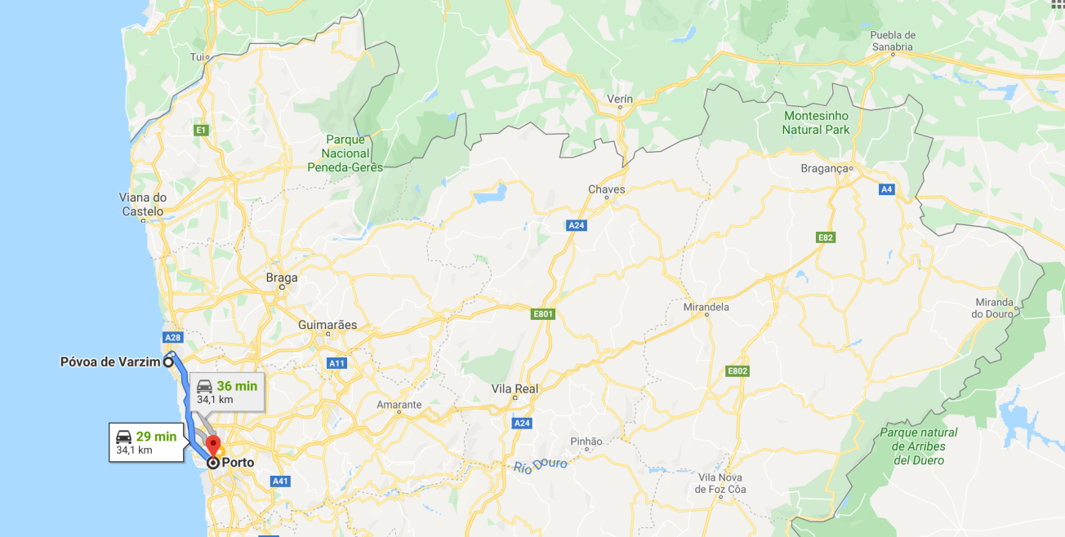
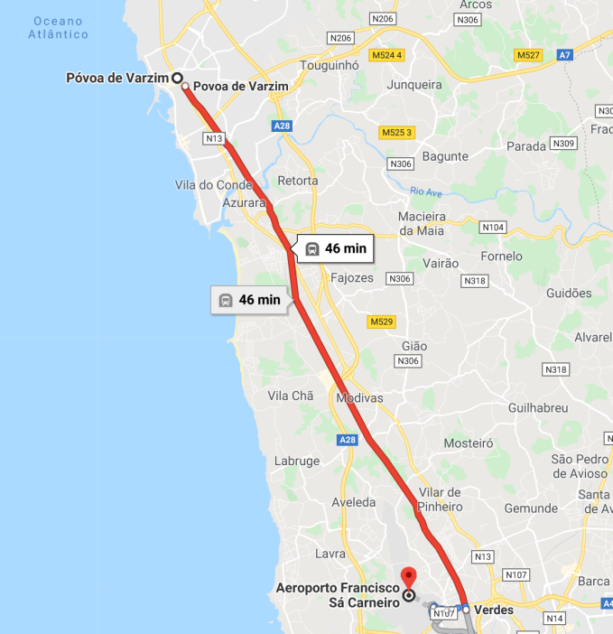
C1 – Training course
Location
Póvoa de Varzim
34km from Porto city
Participants can take the surface metro from Oporto Aeroport to Póvoa de Varzim – take 46min taking LRT (surface metro)

Slide 56
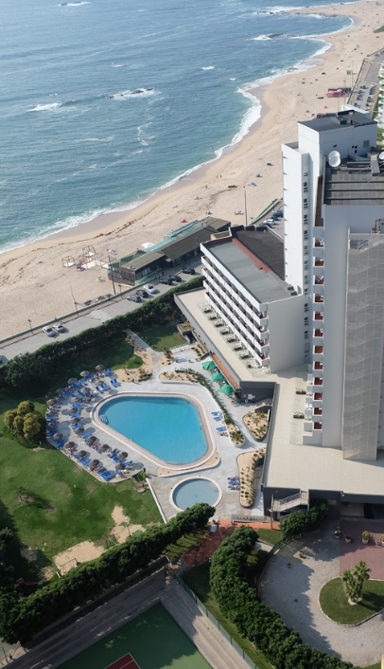

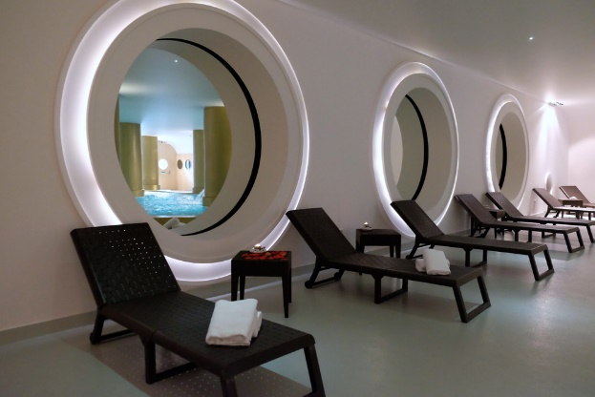
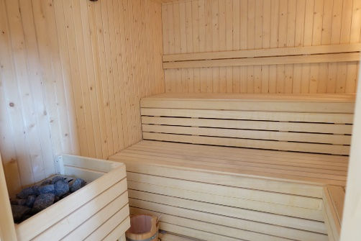
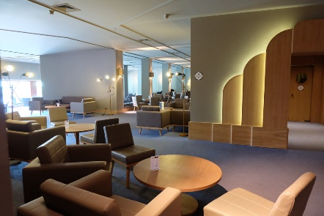

C1 – Training course
Location
Axis Vermar Conference and Beach Hotel – Póvoa de Varzim
https://www.axishoteis.com/pt/Axis-Hoteis/Hoteis/Axis-Vermar/O-Hotel.aspx
Hotel with indoor pool, spa, massages, ….
Near of the beach
1.3 km from the city center

Slide 57
C1 – Training course
Location
Axis Vermar Conference and Beach Hotel
Póvoa de Varzim
Individual Room – 300 euros
Double Room – 200 euros per person
Include :
  4 nights with breafast included
  2 lunches (Tuesday+Thursday)
  4 coffee breaks
  1 spa day

Slide 58
C1 – Training course
Template and Tools
TA.1 – Register
TA.2 – Programme
TA.3 – Certificate
TA.4 – Contents for the Mobility Europass
TA.5 – Participants Profile
TA.6 – Report

Slide 59
C1 – Training course
Deadlines 1/2
30 May 2020
IPB (PT)
Definition of the:
Contents for the Europass
31 July 2020
HEIs
Identify the participants in the training activity and thematic topic, hotel reservation
Contact the National Europass Centre (link) to activate the Europass Mobility for each participant
30 October 2020
HEIs
Elaborate some individual literature review

Slide 60
C1 – Training course
Deadlines 2/2
2 – 6 November 2020
IPB (PT)
Delivery of the training activity and sending to Pixel of the related material (register and report on the training activity)
15 December 2020
IPB (PT)
Sending to Pixel of supporting documents (Report on the training activity, Register of participants, Programme, Certificates)
15 December 2020
HEIs
Sending to Pixel of supporting documents: copies of the Europass certificates, description of the participants profiles and selection methodology

Slide 61
Project Management
PM1 - Coordination of activities

Slide 62
PM1 - Coordination of activities 1/5
Actions to be Carried Out
Attendance to the partners meeting
  1st Meeting: Florence (IT), October 2018
  2nd Meeting: Kaunas (LT), May 2019
  3rd Meeting: Limerick (IE), December 2019
  4th Meeting: Braganca (PT), 25 – 26 June 2020
  5th Meeting: Iasi (RO), February 2021
Production of project reports

Slide 63
PM1 - Coordination of activities 2/5
Templates and Tools
PM1.D – In progress activities reports
PM1.E – Financial Manual (external annex)
PM1.F – Financial Forms
PM1.G - Template of Mobility Declaration

Slide 64
PM1 - Coordination of activities 3/5
Expected Results
Production of:
Three months period online Activities Reports
Yearly Financial Report

Slide 65
PM1 - Coordination of activities 4/5
Current Results
Partner | Online Activity Reports
IE_LIT | Updated 30 November 2019
IT_Pixel | Updated 30 November 2019
IT_UniGenova | Updated 30 November 2019
LT_KTU | Updated 30 November 2019
PT_IPB | Updated 30 November 2019
RO_EuroED | Updated 30 November 2019
RO_UniIasi | Updated 30 November 2019

Slide 66
PM1 - Coordination of activities 5/5
Deadlines
All partners
Every three months (28 February 2020-2021, 30 May 2020, 30 August 2020, 30 November 2020)
  Production of Activities Report Forms
15 March 2021
Financial Reports

Slide 67
Project Management
PM2 - Dissemination

Slide 68
PM2 - Dissemination 1/6
Actions to be Carried Out
  Development and translation of project brochures
  Organization of at least 1 dissemination event on the project every month
  Creation of a Facebook page
  Production of the best practice dissemination report
  Production of transnational dissemination report
  Mobile version of the web site: http://host1.allyou.srl/00progetti/mathe/

Slide 69
PM2 - Dissemination 2/6
Templates and Tools
  PM2.A – In progress dissemination reports
  PM2.B – How to write the Best Practice Dissemination Report

Slide 70
PM2 - Dissemination 3/6
Expected Results
Project Brochure in all partners languages
Database of dissemination events on the portal
Facebook Page
National Best Practice Dissemination Report
Transnational Dissemination Report

Slide 71
PM2 - Dissemination 4/6
Current Results
Partner | Dissemination Events
IE_LIT | 17
IT_Pixel | 56
IT_UniGenova | 13
LT_KTU | 19
PT_IPB | 28
RO_EuroED | 24
RO_UniIasi | 11

Slide 72
PM2 - Dissemination 5/6
Deadline
Every three months (28 February 2020-2021, 30 May 2019-2020, 30 August 2019-2020, 30 November 2019-2020)
All partners
Upload of 1 dissemination events per month
Every month
All partners
Contribute to the Facebook page
28 February 2021
All partners
Final Best Practice Dissemination Report

Slide 73
Project Management
PM3 - Exploitation

Slide 74
PM3- Exploitation 1/4
Actions to be Carried Out
  Involvement in the project of associated partners
  Collection of exploitation links

Slide 75
PM3- Exploitation 2/4
Templates and Tools
  PM3.A - Associated Partner Letter
  PM3.B - Associated Partner Information
  PM3.C - Exploitation links

Slide 76
PM3 - Exploitation 3/4
Expected Results
Involvement of 6 associated partners
Collection of 6 exploitation links

Slide 77
PM3 – Exploitation 4/6
Current Results
Partner | Associated Partners | Registered Organisations | Exploitation Lnks
IE_LIT | 1 |  | 2
IT_UniGenova | 2 | 1 | 3
LT_KTU |  |  | 6
PT_IPB | 2 | 1 | 3
RO_EuroED | 3 |  | 5
RO_UniIasi

Slide 78
PM3: Exploitation 4/4
Deadlines
31 December 2019
All Partners
Involvement of 1 associated partners
Collection of 1 exploitation links
31 March 2020
All Partners
Involvement of 3 associated partners
Collection of 3 exploitation links
15 February 2021
All Partners
Involvement of a total number of 6 associated partners
Collection of a total number of 6 exploitation links

Slide 79
Project Management
PM4 - Quality and
Monitoring Plan

Slide 80
PM4: Quality and Monitoring Plan 1/4
Actions to be Carried Out
  Collection of testimonials
  Production of testing evaluation report
  Production of transnational evaluation report

Slide 81
PM4: Quality and Monitoring Plan 2/4
Templates and Tools
  PM4.A – Quality Plan
  PM4.B – Project Meeting Evaluation Questionnaire (partners)
  PM4.C – Project Evaluation Questionnaire (partners)
  PM4.D – Evaluation Questionnaires for Intellectual Outputs (end users)
  PM4.E – Tool for questionnaires analysis
  PM4.F – How to write the Evaluation Report on Intellectual Outputs

Slide 82
PM4: Quality and Monitoring Plan 3/4
Expected Results
3 issues of the Quality Plan
6 testimonials per country
20 evaluation questionnaires per country
1 Testing Evaluation Report per country

Slide 83
TA4: Quality and Monitoring Plan 4/4
Deadlines
31 January 2021
All Partners
Collection of 6 testimonials
Collection of 20 evaluation questionnaires
Sending of evaluation report on the IOs

Slide 84
Thank you for Your Attention
Questions?

